Slide 1
Auto Pilot
Task 5

Slide 2
Team 4
B.N. | Sec | Name
37 | 2 | Mohammed Ahmed Hassan Ahmed
1 | 1 | Ibrahim Thabet Allam
39 | 2 | Mohammed Hatem Mohammed Saeed
41 | 2 | Mohamed Hassan Gad Ali
43 | 2 | Mohammed Abd El MawgoudGhoneam

Slide 3
Table of content:
Introduction.
Design pitch controller with pitch rate feedback.
Testing Pitch Controller on the Full State Space Model.
Necessity of velocity control.
Check by using SIMULINK.

Slide 4
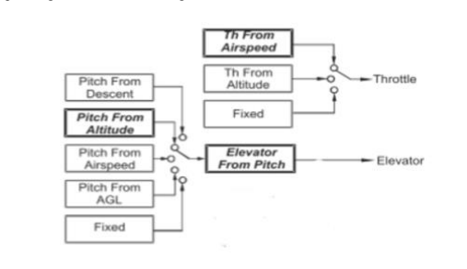
Introduction:
To make a pitch angle controller first of all we should get the transfer functions of all full longitudinal dynamics model.
Our methodology is to using inner loops architecture.
Then using SISO tool to get design the controller.
Finally we use SIMULINK to check the performance of our design.

Slide 5
Design pitch controller with pitch rate feedback
1- Then the open loop transfer function is:
CL_theta_theatcomm =
527 s^2 + 1848 s + 74.13
--------------------------------------------------------------------------
s^5 + 16.43 s^4 + 108.3 s^3 + 441.9 s^2 + 18.57 s + 1.377

Slide 6
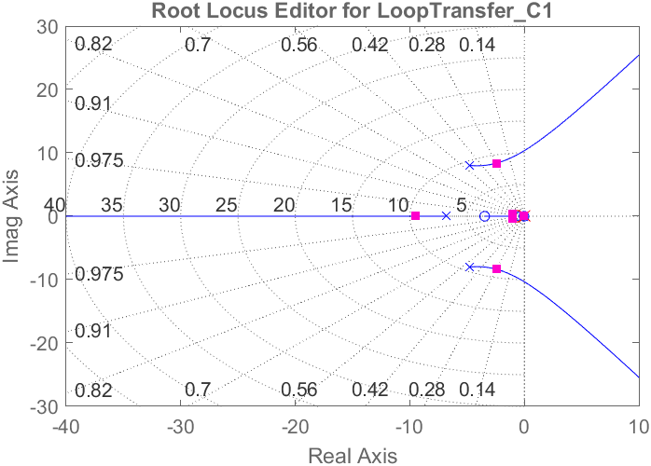
SiSO tool design
Root locus

Slide 7
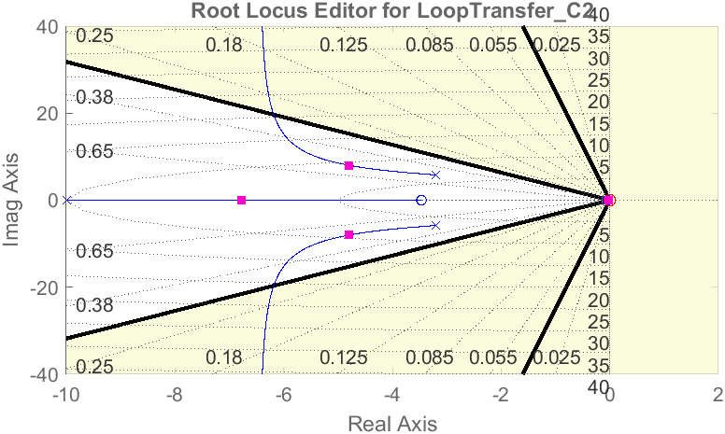
Sisotool design
Root locus

Slide 8
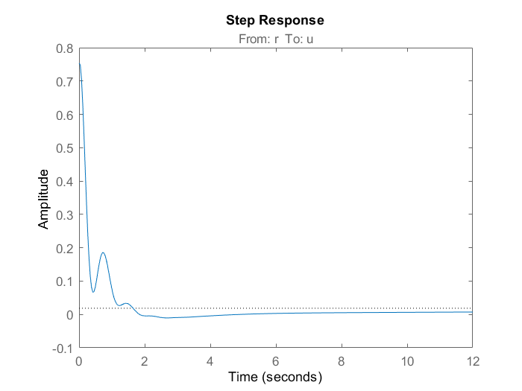
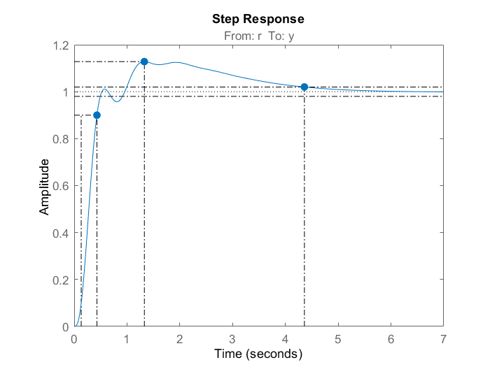
Step response
Control action
Closed loop Tf

Slide 9
Simulink test

Slide 10
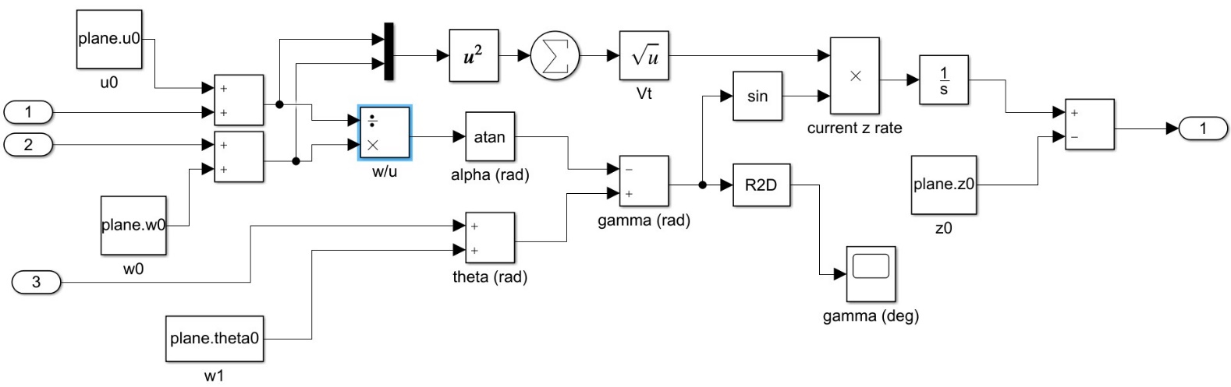
Simulink test

Slide 11

Necessity of velocity control

Slide 12
Necessity of velocity control
when we input positive pitch angle, the action depends on the thrust if the thrust is big enough to climb upward the airplane will climb upward if the thrust is not enough the airplane would dive downward but logically, when the pilot input a positive pitch the airplane should climb upward

Slide 13
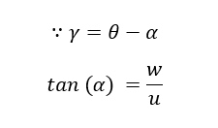
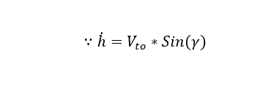
Necessity of velocity control

Slide 14
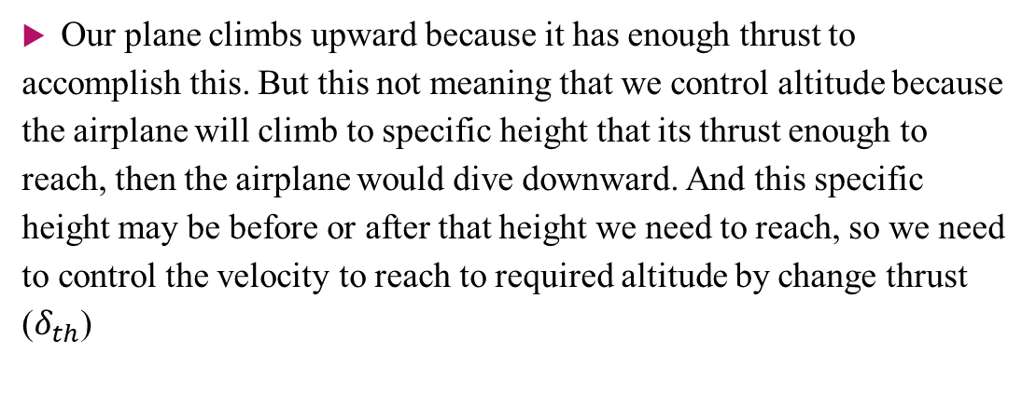
Necessity of velocity control
Our plane climbs upward because it has enough thrust to accomplish this. But this not meaning that we control altitude because the airplane will climb to specific height that its thrust enough to reach, then the airplane would dive downward. And this specific height may be before or after that height we need to reach, so we need to control the velocity to reach to required altitude by change thrust ($δ_{th}$)

Slide 15
Thank You

